Slide 1
RECURRENT NEURAL NETWORK (RNN)
Dr.E.Sivasankar, NIT,Tiruchirappalli-15

Slide 2
Recurrent Neural Network (RNN)
In traditional neural networks, all the inputs, and outputs are independent of each other, but in cases like when it is required to predict the next word of a sentence, the previous words are required and hence there is a need to remember the previous words(as the next word will depend on your previous input).
Example you watch a movie and in between you stop to predict the ending, it will depend on how much you have seen it already and what context has come up yet.
RNN remembers everything. It solves this problem of traditional neural network with a hidden layer.
An RNN remembers each and every information through time. It is useful in time series prediction only because of the feature to remember previous inputs as well.

Slide 3
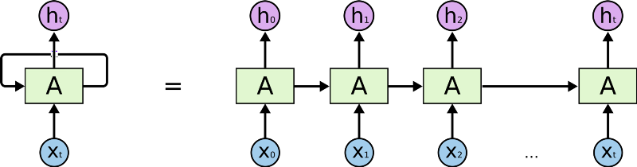
Recurrent Neural Network (RNN)
Working of RNN:
RNN creates the networks with loops in them, which allows it to persist the information. This loop structure allows the neural network to take the sequence of input. If you see the unrolled version, you will understand it better.

Slide 4
Recurrent Neural Network (RNN)
Working of RNN:
RNN converts the independent activations into dependent activations by providing the same weights and biases to all the layers, thus reducing the complexity of increasing parameters and memorizing each previous outputs by giving each output as input to the next hidden layer.
Hence these three layers can be joined together such that the weights and bias of all the hidden layers is the same, into a single recurrent layer.

Slide 5


Recurrent Neural Network (RNN)
Formula for calculating current state:
ht -> current state
ht-1 -> previous state
xt -> input state
Formula for applying Activation function(tanh):
whh -> weight at recurrent neuron
wxh -> weight at input neuron

Slide 6

Recurrent Neural Network (RNN)
Formula for calculating output:
Yt -> output
Why -> weight at output layer

